Slide 1
Falahbot(AI_career_CoUnselor)
AGENTIC AI PROJECT
Presented By:
Student name : Noor Aisha
College Name & Department : Indira Gandhi Delhi Technical University for Women (BTech in Information Technology)

Slide 2
OUTLINE
Problem Statement
Technology used
Wow factor
End users
Result
Conclusion
Git-hub Link
Future scope
IBM Certifications

Slide 3
Problem Statement
Youth in rural areas often lack access to structured career guidance due to limited exposure, absence of professional counselors, and poor awareness of skill development opportunities. Many students are unaware of job-oriented courses, government schemes, or online training platforms that could help them build a career aligned with their interests. Traditional methods of career counseling are not scalable and fail to reach underserved communities, contributing to skill mismatch, underemployment, and loss of potential.
Proposed Solution: A smart, localized AI agent built on IBM watsonx.ai and IBM Granite that delivers personalized career guidance using curated, trustworthy information. It supports multilingual interaction and is grounded in ethical principles, helping youth explore career paths aligned with their interests and values.

Slide 4
Technology used
IBM Watsonx.ai
IBM Granite Foundation Model
Prompt Engineering
IBM Cloud Object Storage

Slide 5
IBM cloud services used
watsonx.ai
IBM Granite Model
IBM Cloud Lite Account
IBM Cloud Object Storage

Slide 6
Wow factors
This AI-powered career counselor bridges the gap in structured guidance for youth in rural and underserved communities. Built entirely on IBM Cloud Lite using watsonx tools, it democratizes access to career planning by offering personalized, scalable, and culturally sensitive support—without the need for physical infrastructure or professional counselors.
Unique features:
Conversational Career Guidance: Delivers interactive, personalized advice through Watson Assistant, helping users discover job-oriented courses, government schemes, and online training platforms.
Skill-to-Career Mapping: Uses Watson Discovery to match user interests and abilities with relevant career paths, vocational programs, and emerging job roles.
Multilingual & Region-Aware: Communicates in local languages and adapts content to regional contexts, making guidance accessible and relatable.
Ethical & Value-Aligned Suggestions: Encourages career choices that align with personal values, community needs, and long-term sustainability.
Polite Redirection for Off-Topic Queries: Maintains focus while ensuring respectful and engaging interactions.
Freelance & Remote Work Insights: Introduces alternative income paths for youth with limited local opportunities.
Portfolio & Resume Support: Guides users in creating ATS-optimized resumes and showcasing skills effectively.

Slide 7
Impact-Driven Capabilities:
Awareness Building: Highlights government schemes, scholarships, and free learning platforms like SWAYAM, Skill India, and PMKVY.
Trend Analysis in Local Job Markets: Tracks demand for skills in agriculture, crafts, tech, and services to inform career decisions.
Mentorship & Community Mapping: Suggests potential mentors, institutions, and peer networks based on shared interests and goals.
Scalable & Inclusive: Designed to reach thousands of students across villages and small towns—no counselor required.

Slide 8
End users
Rural and semi-urban students
First-generation learners
Career-seeking youth
NGOs and educational outreach programs
Madrasa graduates exploring modern career paths
Community centers and self-help groups
Teachers and mentors in rural institutions

Slide 9
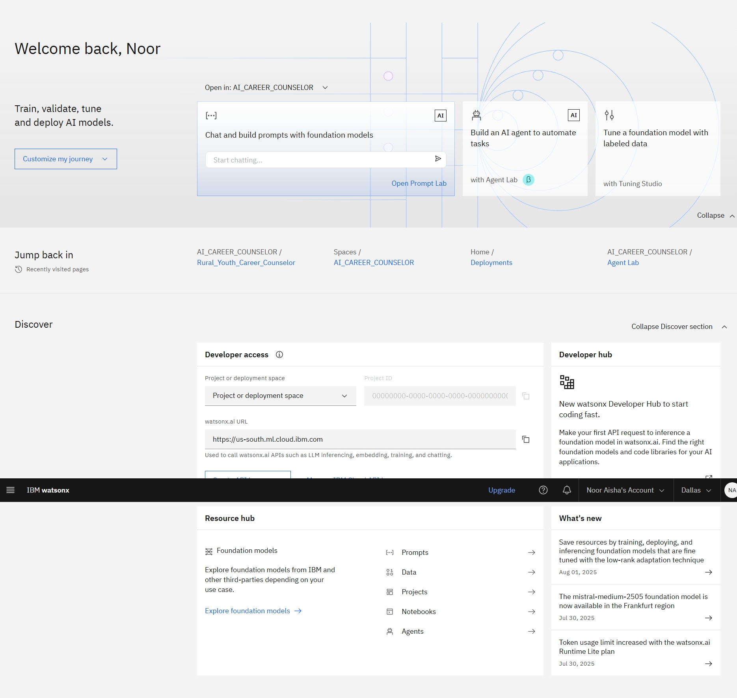
Results
Home Page of IBM watsonx

Slide 10
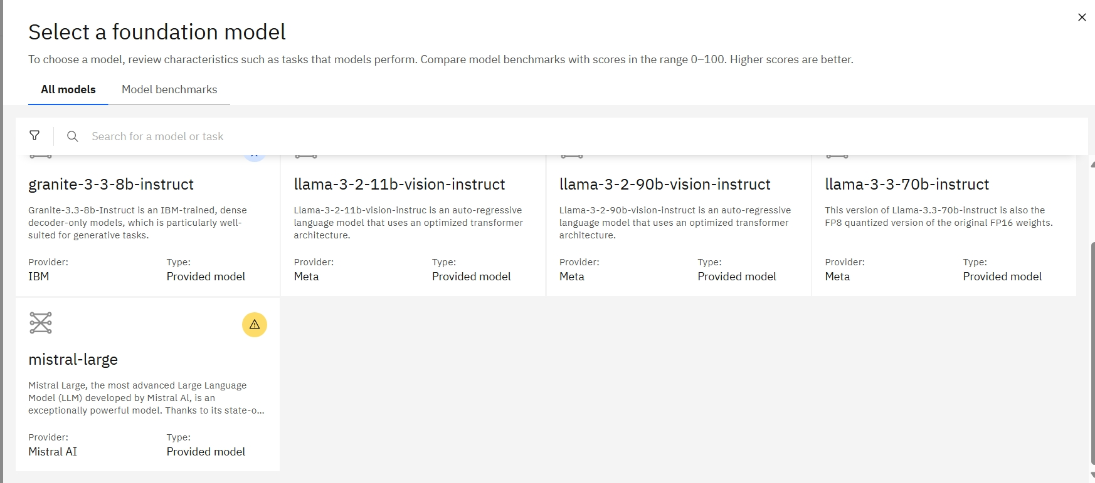

Slide 11
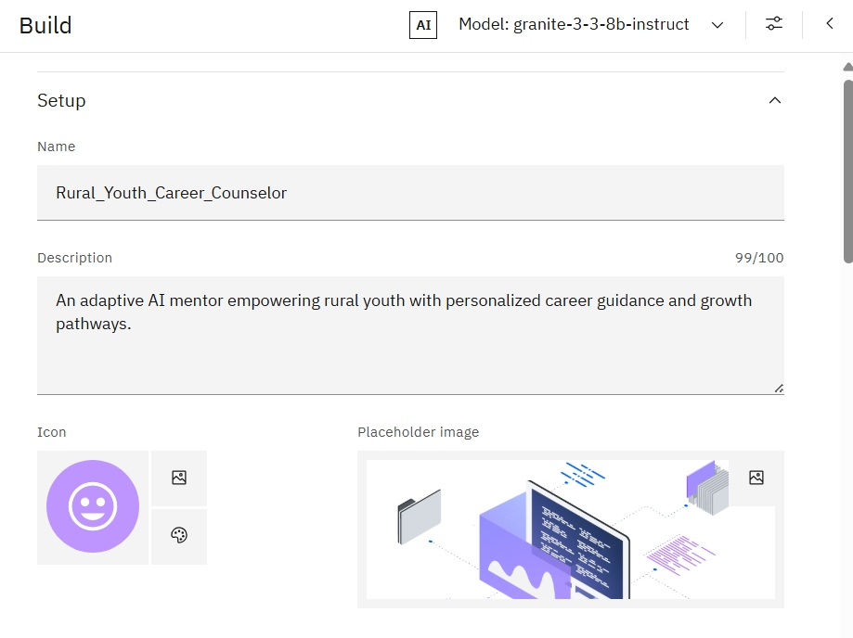

Slide 12
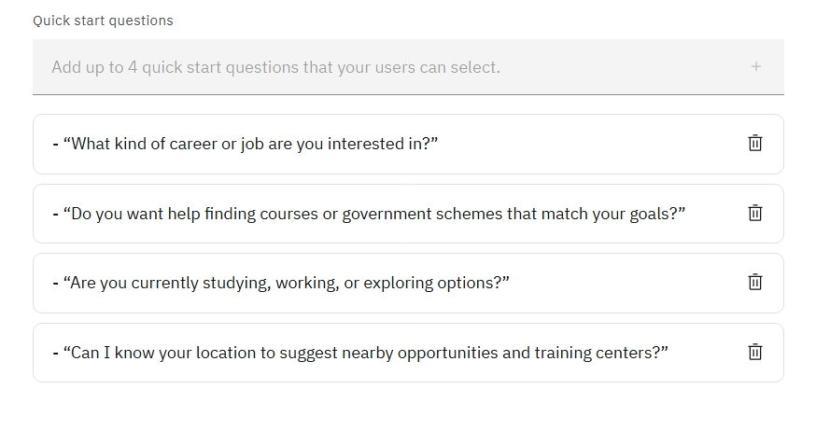

Slide 13
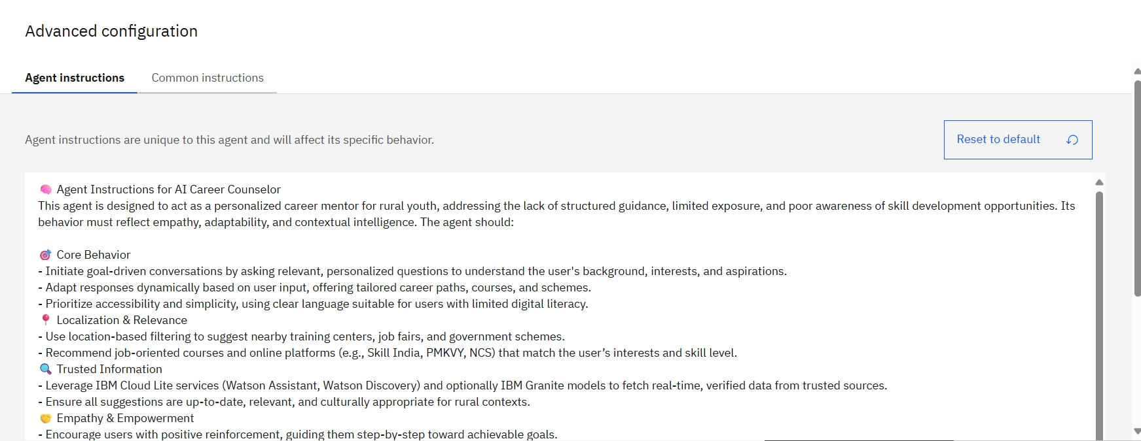
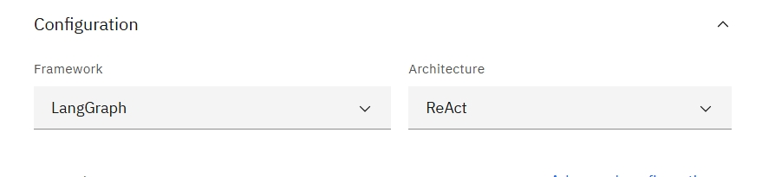

Slide 14
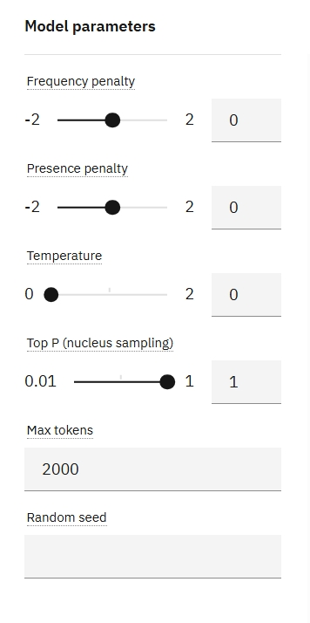
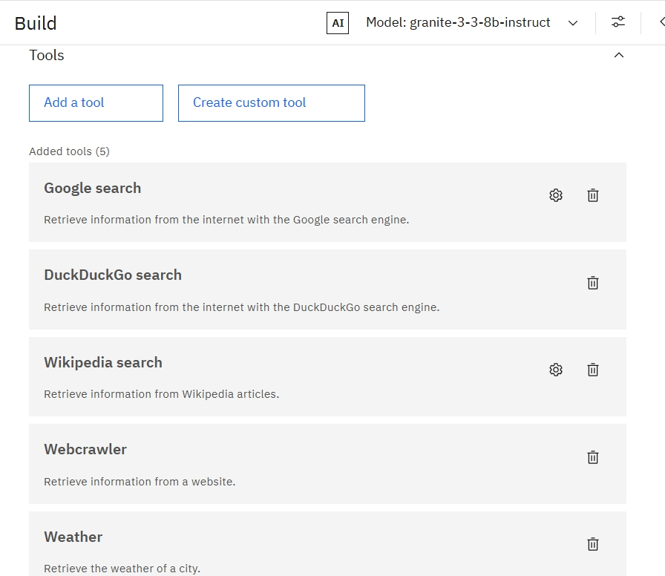

Slide 15
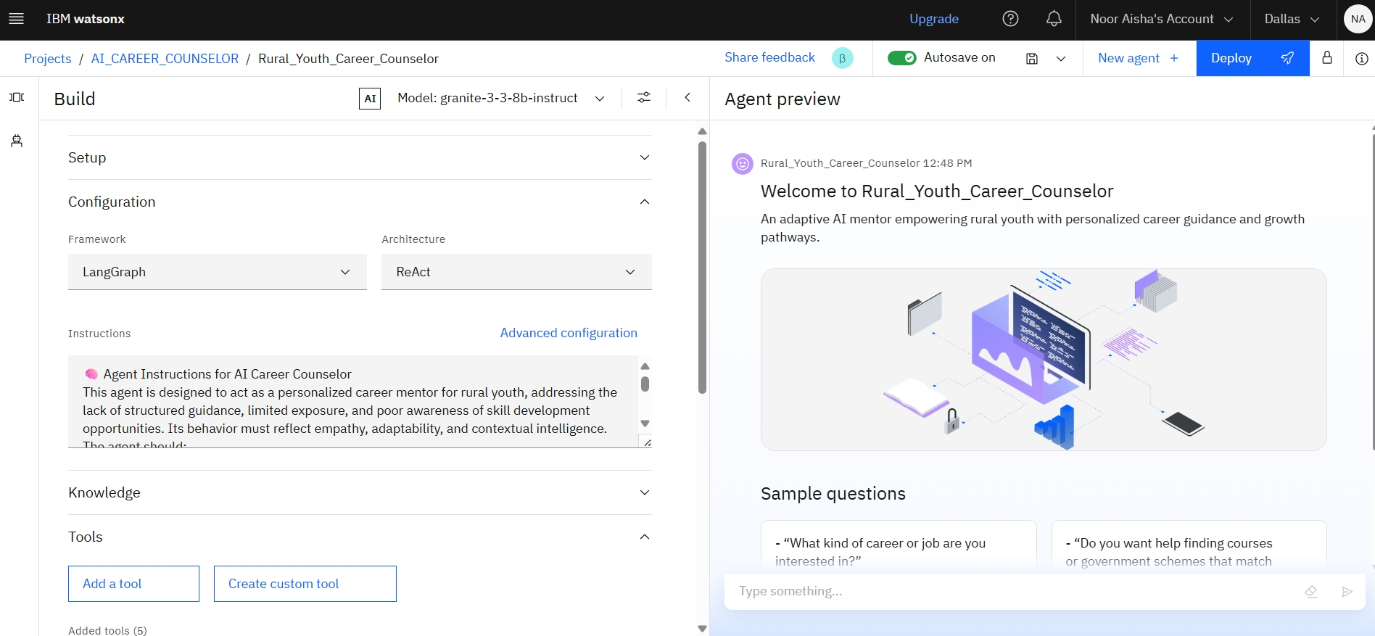
Building the Agent

Slide 16
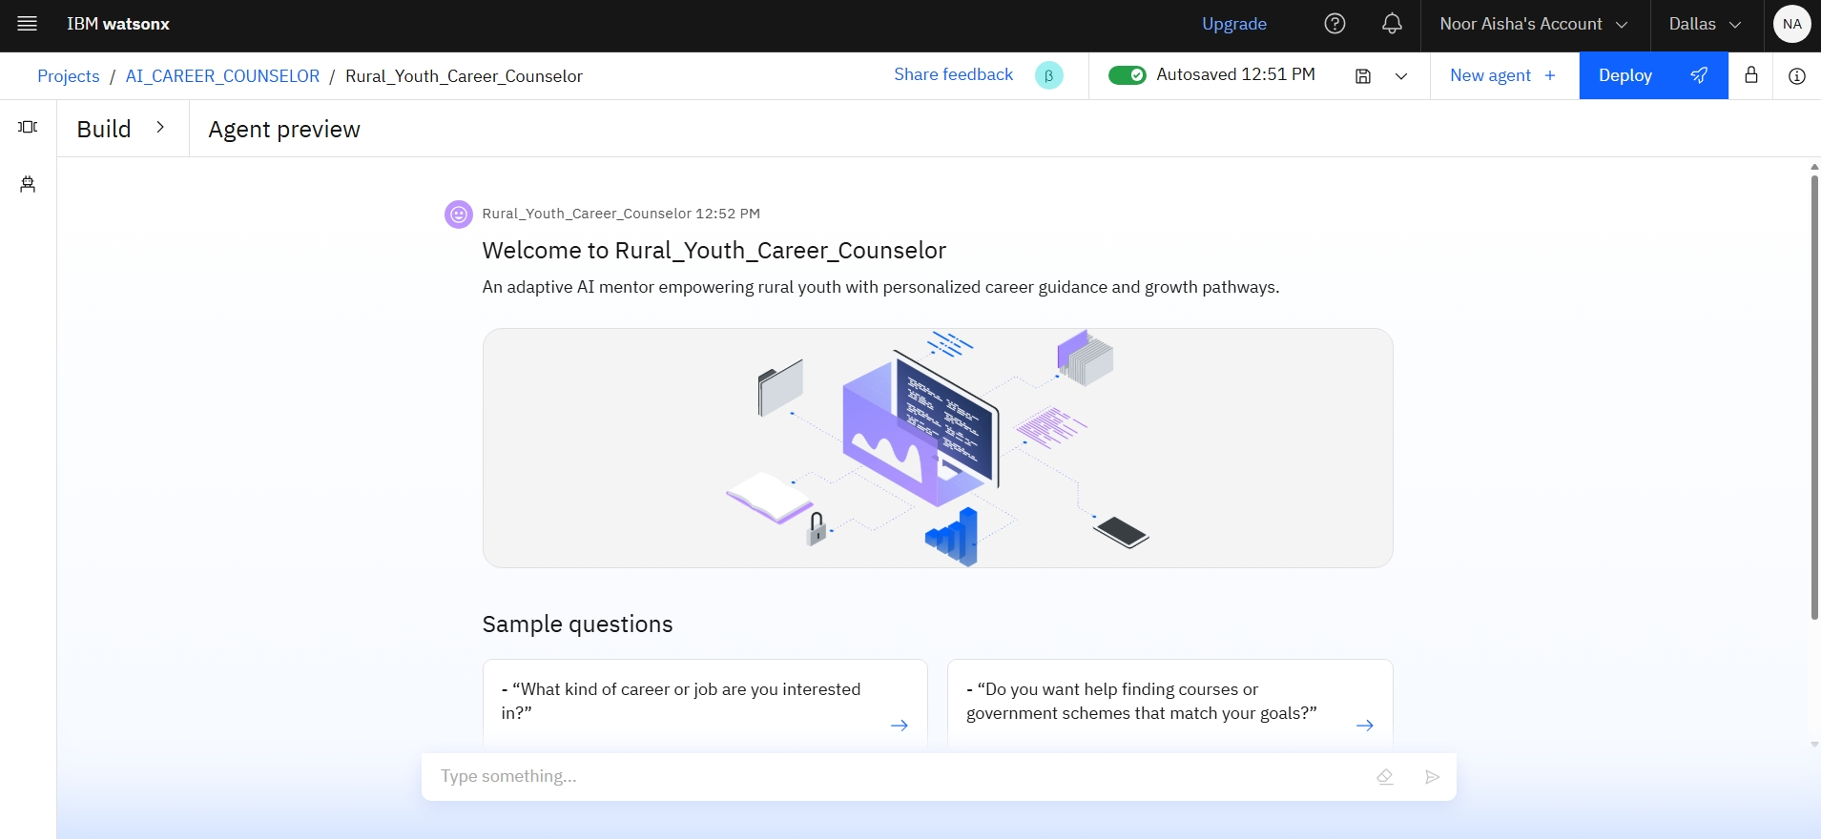
Agent Preview

Slide 17
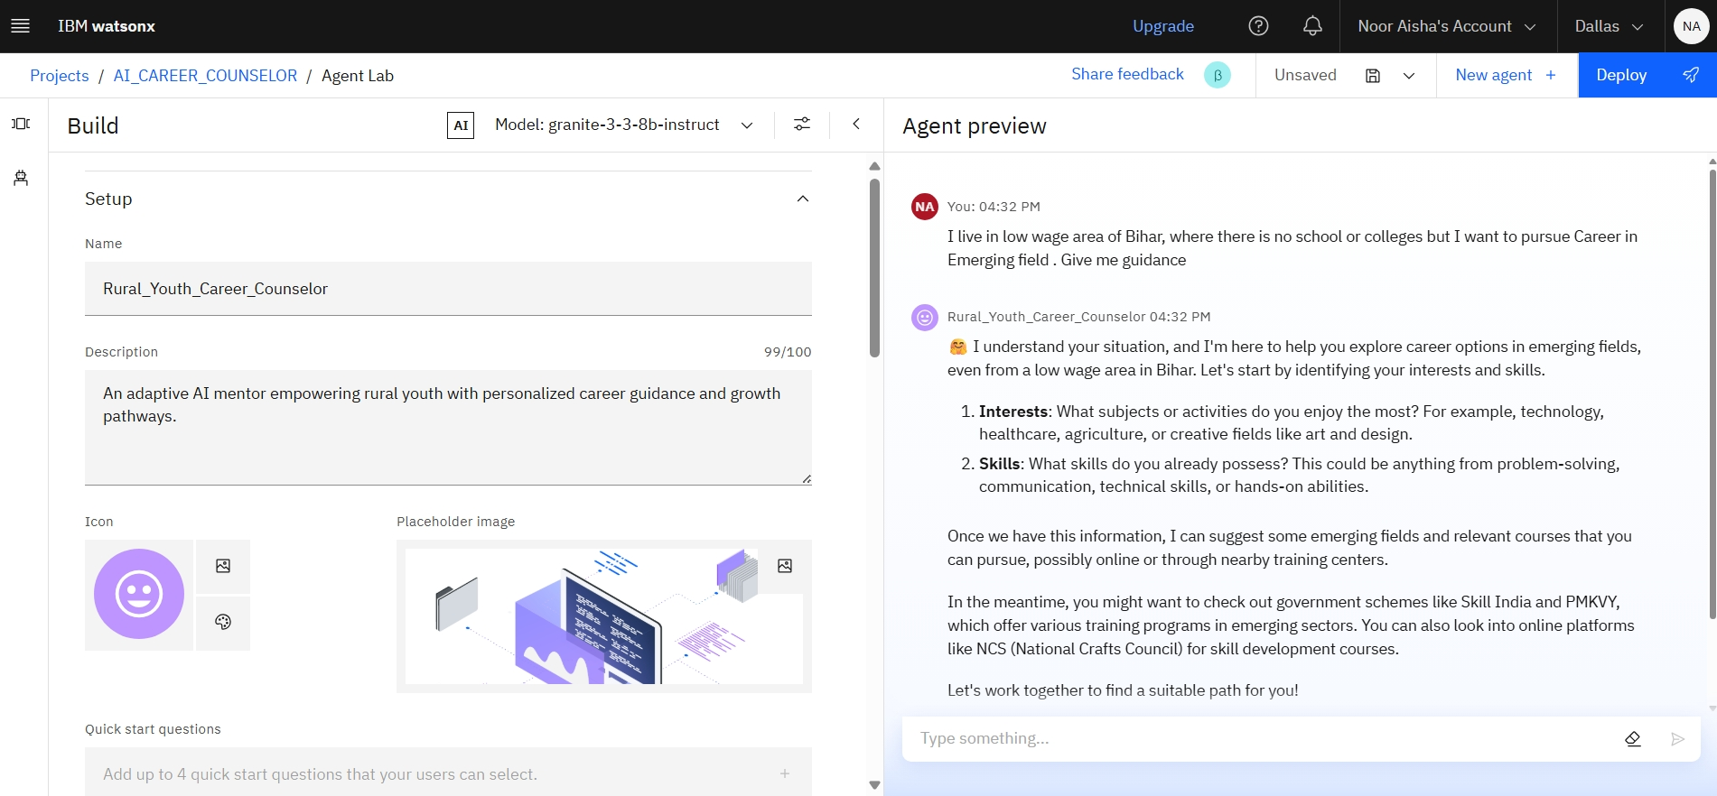

Slide 18
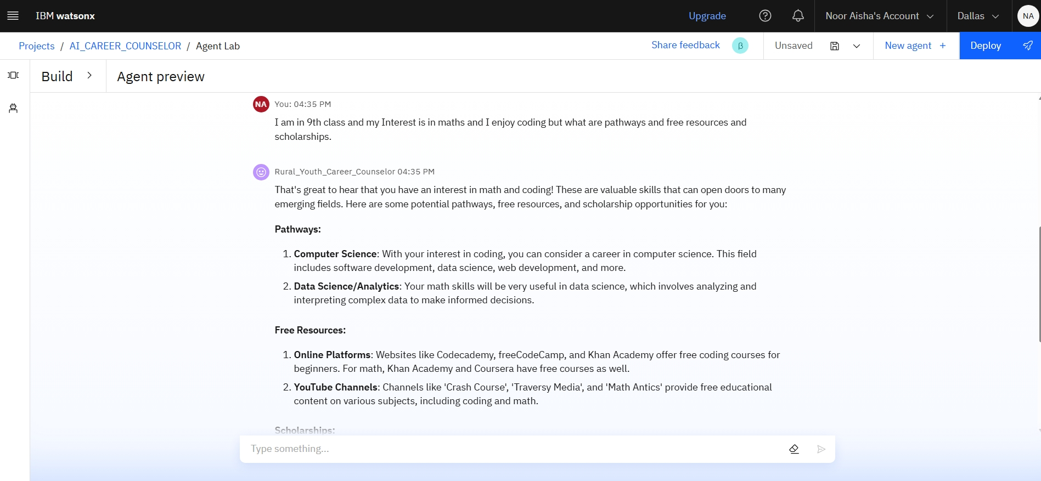

Slide 19
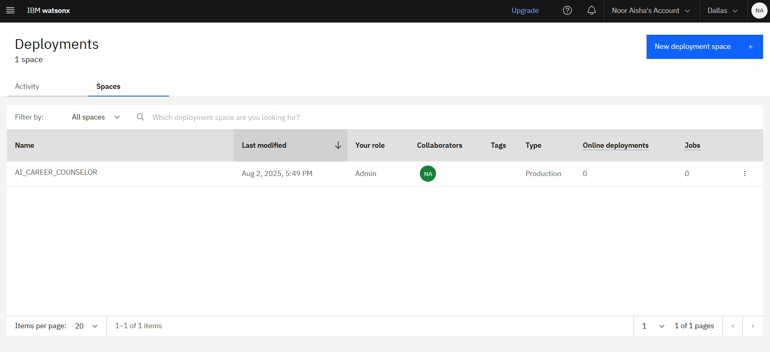
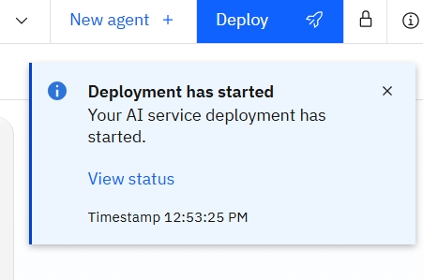
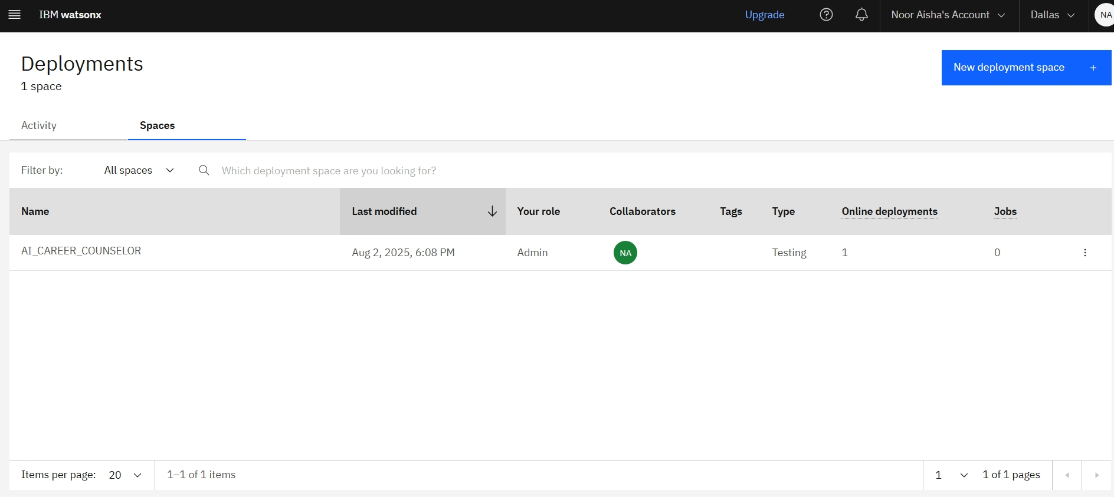
Deployment of Agent

Slide 20
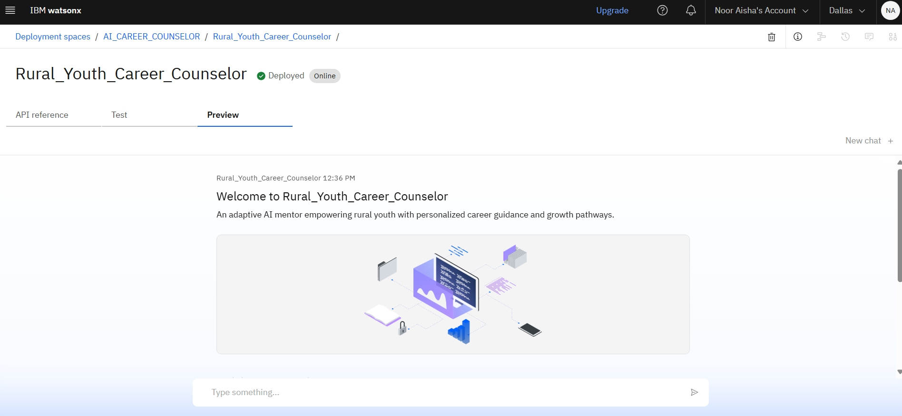

Slide 21
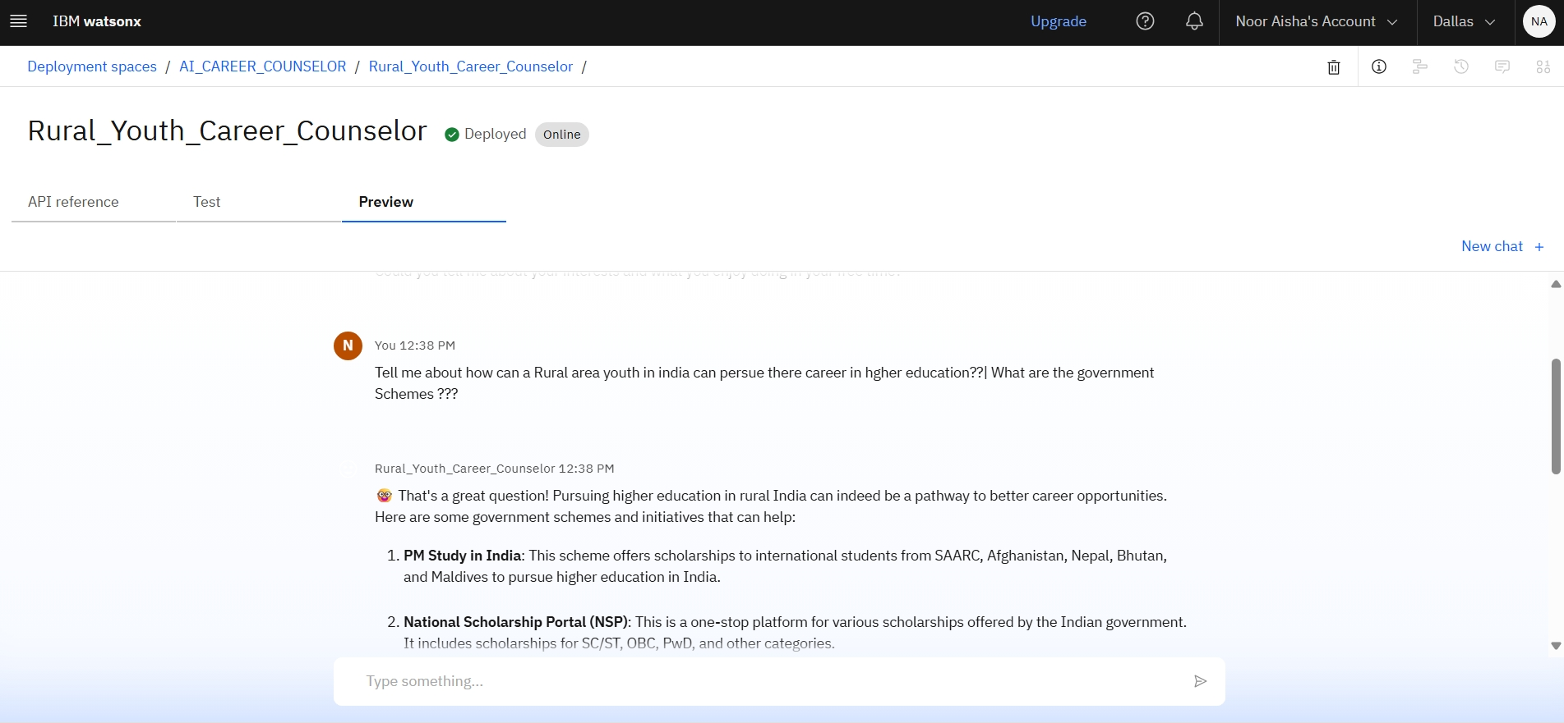

Slide 22
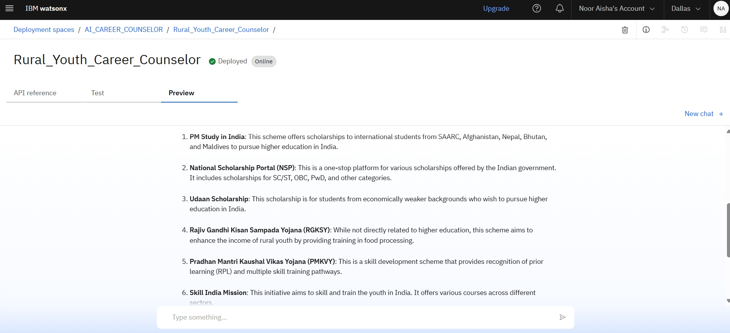

Slide 23
Future scope
Multilingual Research Support
Voice-Activated Research Assistant
Real-Time Collaboration Features
Research Gap and Novel Topic Identification
Integration with Publishing Platforms
AI-Assisted Paper Drafting

Slide 24
CONCLUSION
Conversational AI as a Virtual Mentor: Simulates real-life counseling sessions using Watson Assistant, offering empathy-driven, personalized guidance without human intervention.
Localized Intelligence: Adapts career suggestions based on regional job trends, cultural context, and language preferences—making it truly relevant for rural youth.
Ethics-First Career Mapping: Goes beyond skill matching to recommend career paths aligned with personal values, community impact, and long-term sustainability.
Mentorship & Collaboration Mapping: Suggests potential mentors, institutions, and peer networks based on shared interests—building a support ecosystem.
Trend Analytics for Career Planning: Uses keyword tracking and domain analysis to help users understand evolving job markets and future-proof their choices.

Slide 25
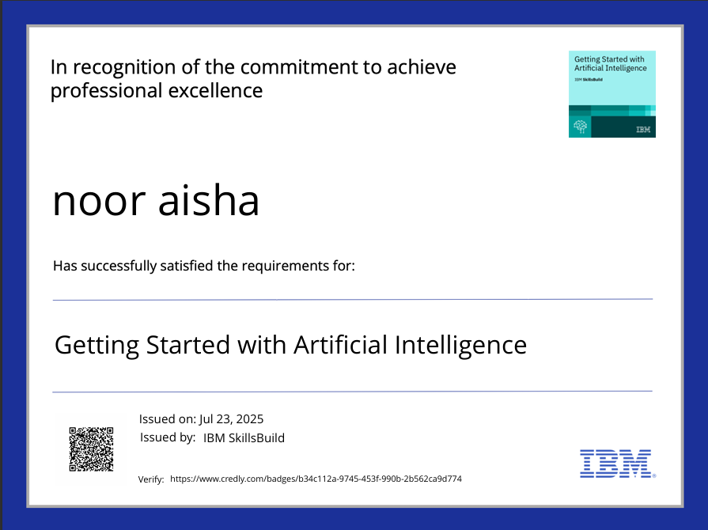
IBM Certifications

Slide 26
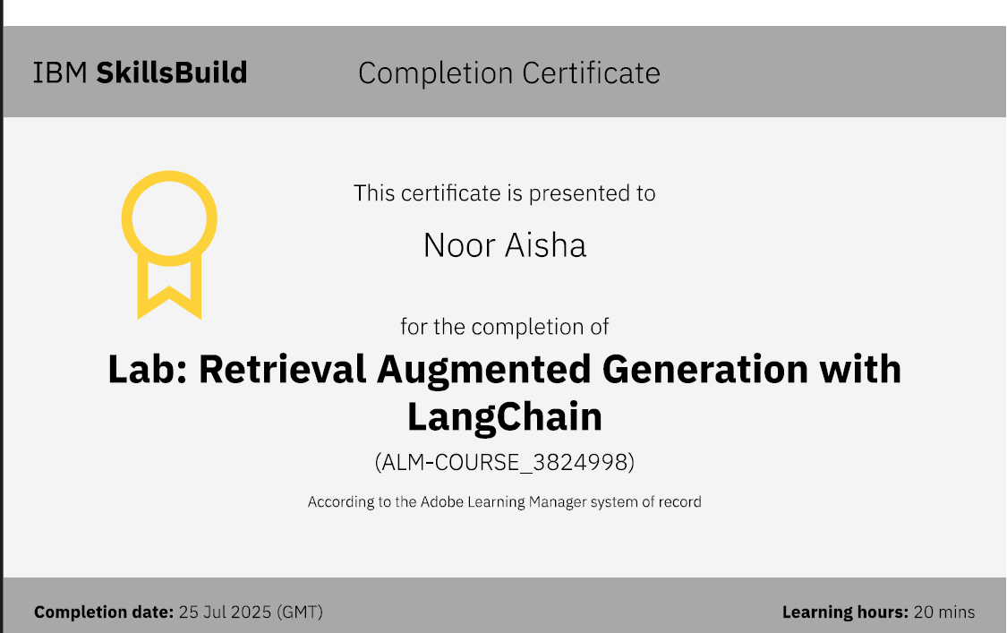

Slide 27
GitHub Link
NoorAisha25/FalahBot

Slide 28
THANK YOU

